Slide 1
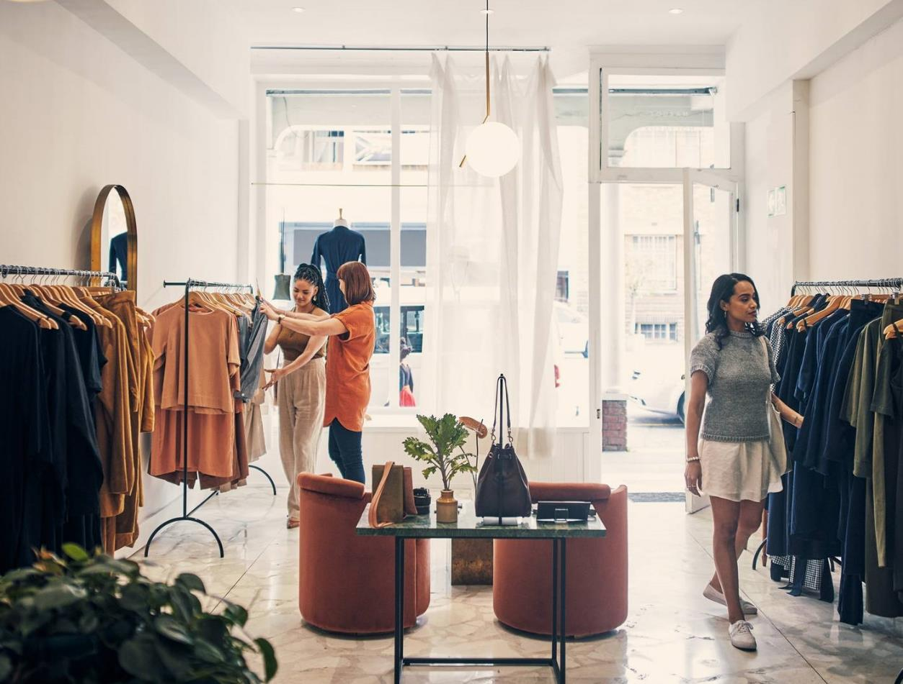
Clothing website
1- Ahmed Magdy Mohammed
2- Bassant Magdy Abdelshafy
3- Adham Atef Hassan Youssef

Slide 2
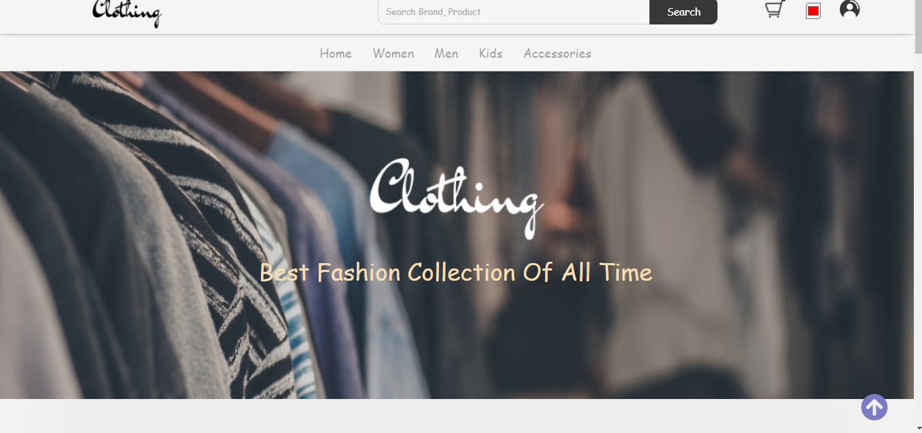
About Us
We are a group of students at the Information Technology Institute. We have created a fashion business website using HTML,CSS and JavaScript.

Slide 3
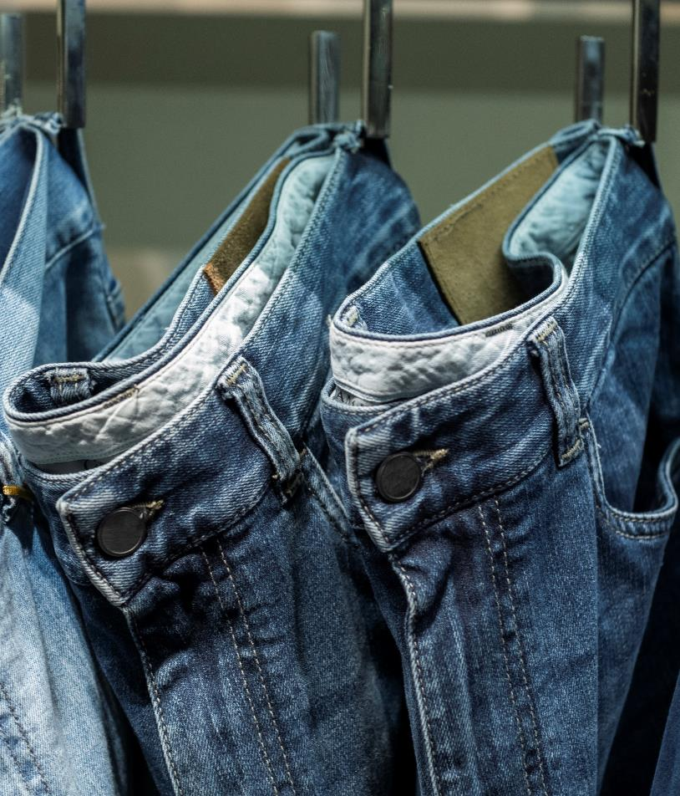
Problem
Market gap
Online shopping continues to be consumer driven, but we're seeing a lapse of availability in the market for small business online shopping experience
Customers
A great number of Egyptian customers now shop online

Slide 4
The site has been divided into four parts
Women Section
Men Section
Kids Section
Accessories Section
The women's department takes care of her clothes
The men's department takes care of his clothes
The kids department takes care of their clothes
The accessories department takes care of both men's and women's accessories

Slide 5
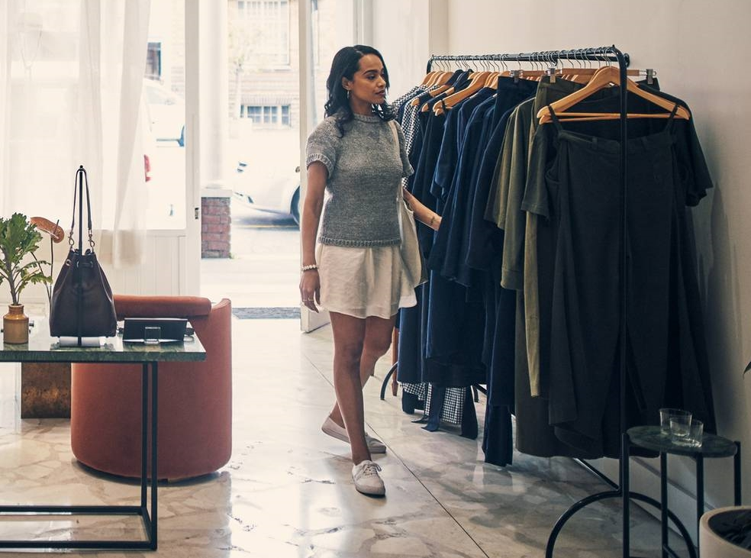
User Registration

Slide 6
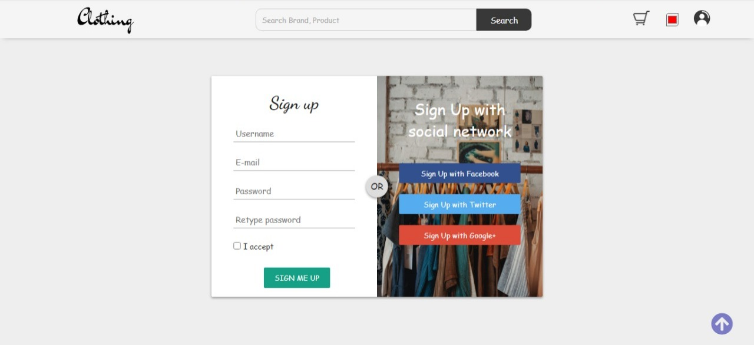
Sign Up Screen

Slide 7
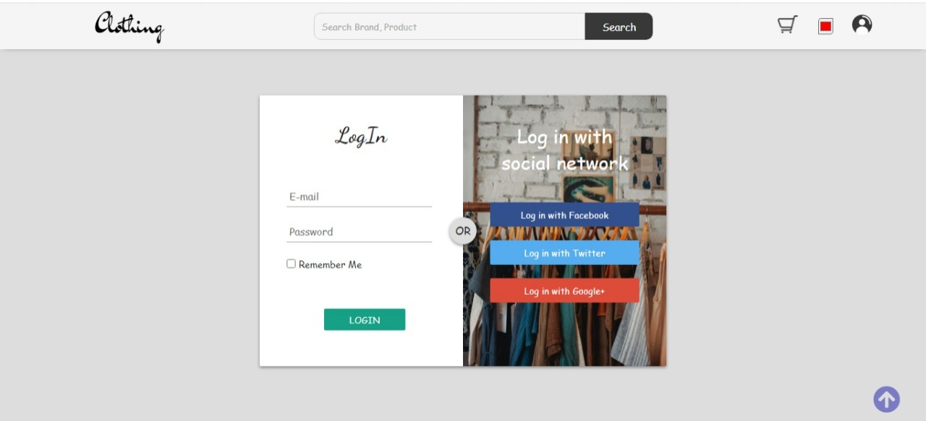
Login Screen

Slide 8
Main Pages

Slide 9
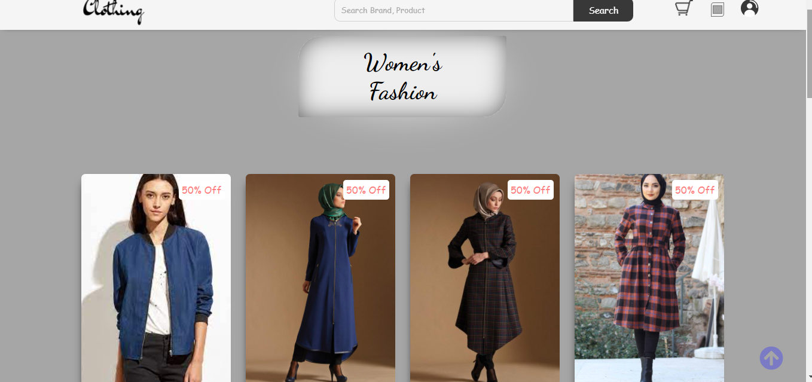
Women Page

Slide 10
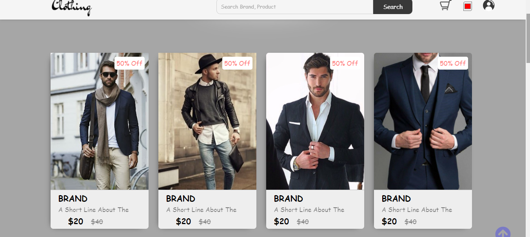
Men Page

Slide 11
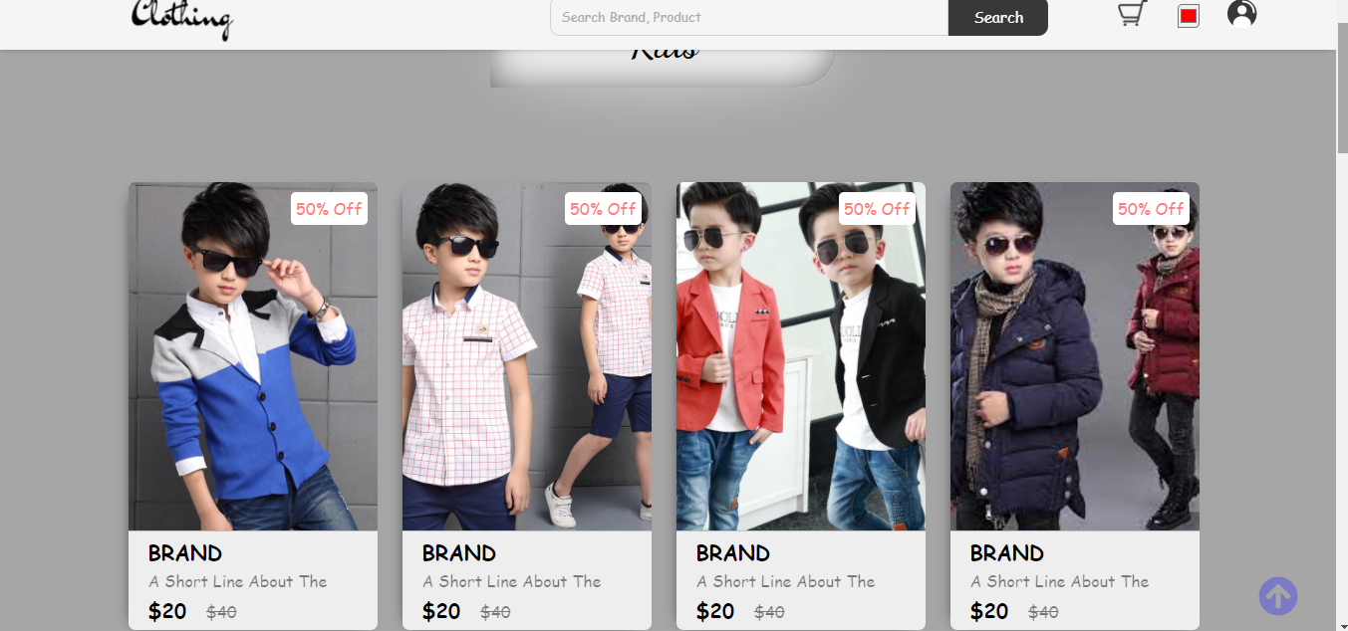
Kids Page

Slide 12
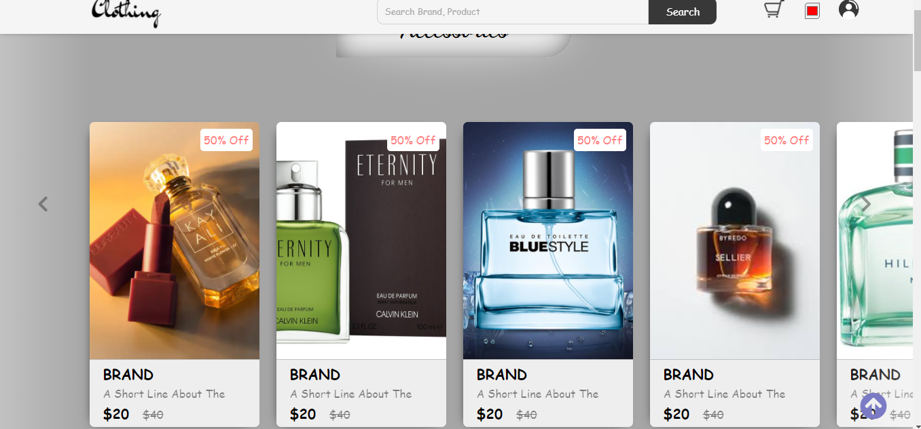
Accessories Page

Slide 13
Error Page

Slide 14
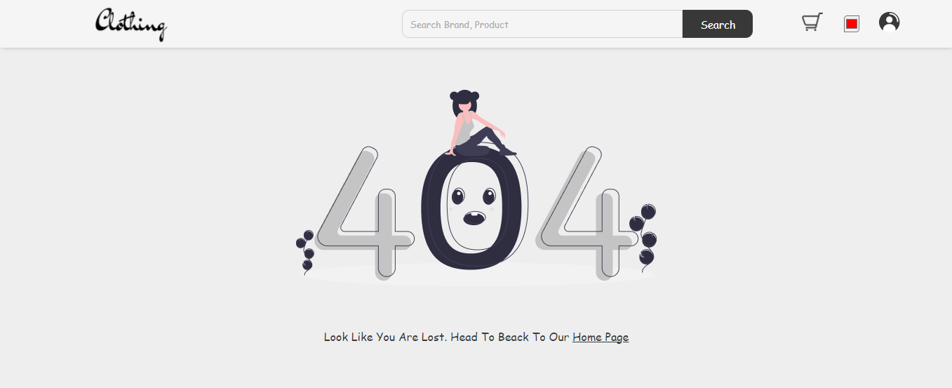

Slide 15
Cart Page

Slide 16
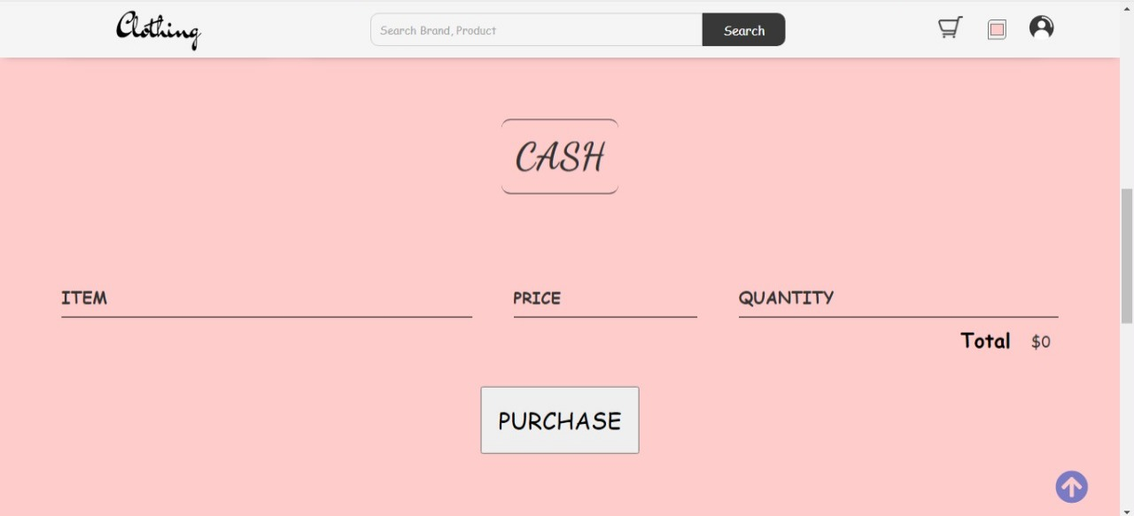

Slide 17
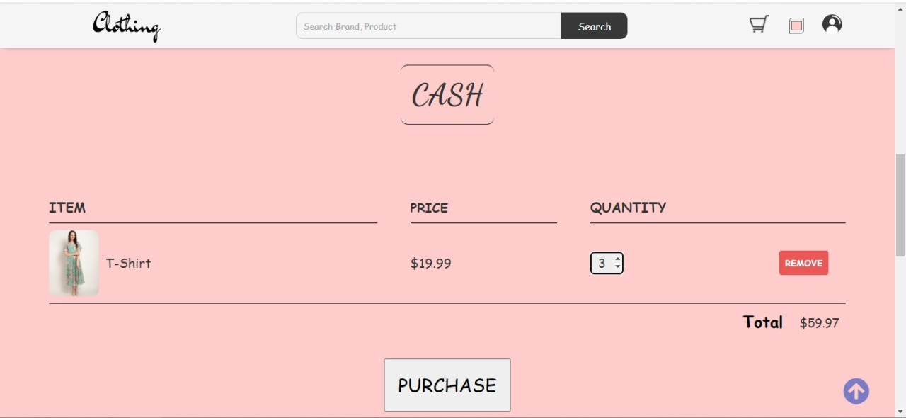

Slide 18
Thank you

